Slide 1
Community Solar and To Be Determined Disclosure AV Guidance
November 2024

Slide 2
Table of Contents
WHAT and WHY:
TBD Description and Process Overview
Overall AV Role & Responsibility
WHEN:
New CS Bulk Upload Templates and Notification Capability Go Live – November 8,2024
WHERE and HOW:
What do I need to get started
Location of the Revised CS Upload Templates
How to Complete and Submit the Upload Templates
How to Manage TBD Notifications
Update Statuses in the new CS Bulk Upload Template
TBD Cancellations
TBD Extension
Project Assignment
Additional Support: Bulk Upload Video
FAQs

Slide 3
CS and TBD Disclosure Form Instructions
Elevate is providing instructions to Approved Vendors (AVs) for completing Community Solar (CS) and “To Be Determined” (TBD) Disclosure Forms in support of the Illinois Solar for All (ILSFA) program in adherence with Section V(B) Standard Disclosure Forms and Requirements for Contract Execution of the Illinois Power Agency (IPA) Consumer Protection Handbook (CP Handbook) effective June 2024.
TBD Disclosure Forms are used for recipients that desire a subscription to a Community Solar (CS) project and where the Approved Vendor (AV) or Designee has not identified the specific CS project at the time of the recipient’s enrollment.
The TBD Disclosure Form process went into affect October 4, 2024.
New CS Disclosure Bulk Upload Templates and notification capability are available as of November 8, 2024.

Slide 4
Overall TBD Disclosure Process Steps
Generating a TBD Disclosure Form can include the following steps:
Project Assignment
TBD Extension
TBD Cancellation
TBD Designation
TBD Notifications

Slide 5
Overall AV Role & Responsibilities
Vendors must be approved by the IPA to submit project applications to ILSFA.
AVs must administer the CS and TBD disclosure process in accordance with the CP Handbook, including:
Executing a signed, correct Disclosure Form with the Recipient (see next slide).
Submitting the Disclosure information to the Program Administrator via the Recipient Verification and Bulk Upload Templates.
Ensuring on time notifications and evidence in alignment with the CP Handbook.
Updating TBD statuses for cancellation, extensions and project assignment as relevant using the Bulk Upload Template and the Portal.
Designees:
Designees may be responsible for acting on behalf of an AV to satisfy AV requirements.
AVs are accountable for managing and supervising a Designee that markets CS projects.

Slide 6
What do I need to Get Started?
First steps:
Complete a CS Disclosure Form with the recipient (follow the appropriate PDF below for guidance).
Requirements:
Recipient desires a subscription to a CS project AND
Project assignment is not confirmed.
AV must determine 2 to 5 available projects for potential assignment.
Note: From the available CS projects, the project with the lowest ACF will be used to calculate all savings.
If TBD, complete a CS TBD Disclosure Form with the recipient (follow the appropriate PDF below for guidance).
Initiate the CS Recipient Verification (optional) and Bulk upload templates (see next slides).

Slide 7
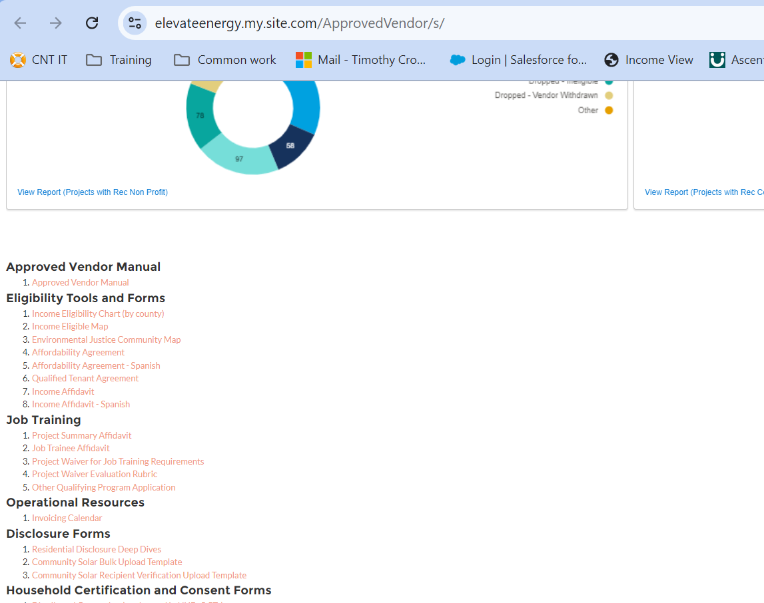
Location of the Revised CS Upload Templates (Salesforce)
The bulk upload templates are used for the CS Residential and Anchor Tenant Disclosure data upload, and now contain data fields to indicate a TBD Disclosure option.
New upload templates are available as of November 8, 2024.

Slide 8
How to Complete and Submit the Upload Templates
Optional: If preferred to create the RECIPIENT(S) via the bulk upload process, complete the Recipient Verification Bulk Upload Template and upload in the portal as a csv (see Instructions tab as shown on next slide).
The ILSFA AV Manager will then upload to the Portal.

Slide 9
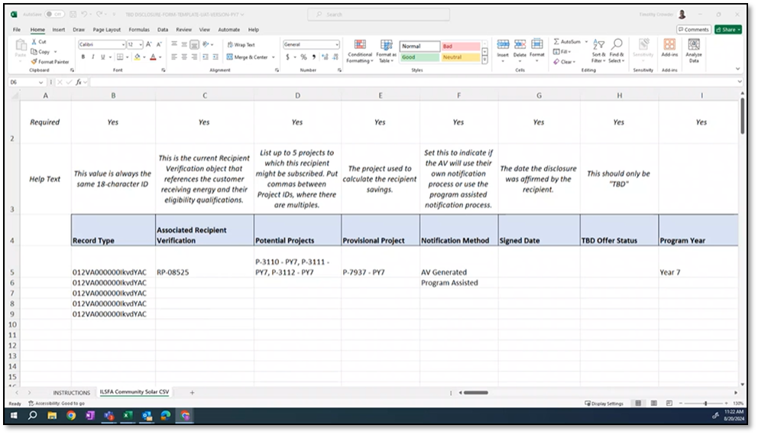
How to Complete and Submit the Upload Templates
Complete the CS Bulk Upload Template. (New fields AX-BI were added in support of the TDB Disclosure form option.)
Refer to the Instructions tab and complete all relevant data fields.

Slide 10
New Fields AX-BI
Fields AX-BI have been added in support of the AV’s calculations for
first year costs
first year savings
value of energy over term
These data fields have been added to the bulk upload template for completion.

Slide 11
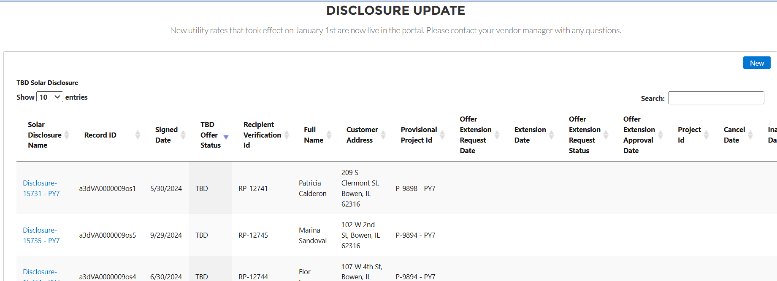
New Portal View Options
See new portal view options that provide more visibility to the number of TBD, CS and Standard Disclosures submitted.

Slide 12
How to Manage TBD Notifications
AVs are responsible for notifications to the Recipient every 30 days after the Disclosure signing date, as described in the CP Handbook.
Using the automated email option provided by the Program Administrator for 30-day notifications:
Not using the automated option:
Use suggested email template on next page.
AV is required to submit all notifications sent to the Recipient to the Program Administrator via email address: TBDNotifications@illinoissfa.com for monitoring compliance with the CP Handbook.
For any Recipient that prefers communications via email.
To elect, AV must indicate in the bulk upload template.
For first-time use, work with your AV Manager to set up this feature. The AV Manager will need the email address that will appear in the notification.
Note: These emails may go to the Spam, or Junk, folder. Please check there before assuming the email was not received.

Slide 13
How to Manage TBD Notifications
Suggested notification language for Email or Direct Mail Letter:
To: [Recipient Name, Email]
From: [Approved Vendor, Email Address]
Subject: " ILSFA Solar Subscription Status Update"
Template / Content: "We appreciate your interest in participating in the ILFSA Community Solar program. Your subscription is still pending as we are working to determine which project will serve your needs best. Once you are assigned to a project, we will notify you with the project identification number, name, and location within 14 days of assignment. If you have any questions, you can contact me at [AV Contact Name, Phone Number, Email]."

Slide 14
Managing TBD Status Changes
TBD Disclosure Cancellation
TBD Disclosure Extension
Project Assignment

Slide 15
Bulk Upload Template - Cancellations
When cancellation is offered
If the Recipient has not been assigned to a project within 180 days (plus any approved extension), the AV must offer cancellation to the Recipient.
How – steps to take when cancelling
With the Recipient:
Notify the Recipient of the cancellation (see next slide for example language).
Provide the Recipient with a listing of potential CS Projects and AVs to work with (https://www.illinoissfa.com/approved-vendors/).
With the Program Administrator:
Indicate the TBD Disclosure status as ‘canceled’
Provide a cancellation date in the CS bulk upload template.

Slide 16
Bulk Upload Template - Cancellations
Suggested cancellation notification language for Email or Direct Mail Letter:
To: [Recipient Name, Email]
From: [AV Contact Name, Email]
Subject: [ILSFA Solar Subscription Cancellation]
Template / Content: "We appreciated your interest in participating in the ILSFA Community Solar program. We cancelled your subscription due to the unavailability of a project for assignment. You may be interested in signing up for a subscription to a community solar project through another vendor. See Community Solar Offers Document, https://www.illinoissfa.com/approved-vendors/. If you have any questions, you can contact me at [AV Contact Cell, Email]."

Slide 17
TBD Extensions
Coming in January
When
The AV must identify TBD Recipient(s) for which it wishes to extend the assignment deadline prior to the 14th day prior to the 180-day deadline (166 days post-disclosure signing date).
If approved, the AV would have 210 days post-signing date to assign the TBD Recipient to a project.
How
The AV will notify the Program Administrator in the bulk upload template by indicating the status to ‘extend’ and providing the extension date associated to the form.
A note about requirements: The ILSFA AV Manager will:
Review the extension request to ensure extension requirements are met.
If requirements are met, update Salesforce with the extension approval date and notify the AV.
If requirements are not met, will notify the AV of the discrepancy and the option to resubmit the request.

Slide 18
Bulk Upload Template – Project Assignment
Notifying the TBD Recipient
When a TBD Recipient has been assigned to a specific project, the AV must notify the Recipient:
No later than 14 days after project assignment
Via the Recipient’s preferred communication method, email or hard-copy mail.
Provide the following project details, in alignment with the CP Handbook:
Project location, including the county in which the project is located
Project name (as that project’s name appears in the ILSFA Salesforce portal)
Project ILSFA identification number
Project size (in kW AC)
AV name and contact information, if different than the entity sending the communication
CS Provider name and contact information, if different than the AV
Project Status (one of the following):
Completed and producing energy
Completed and awaiting final approval to operate
Under construction
Construction not yet commenced

Slide 19
Bulk Upload Template – Project Assignment
Notifying the Program Administrator
When a project has been assigned to a TBD Recipient, the AV must:
Submit the bulk upload template
mark the TBD Disclosure status as ‘assigned’
provide the assignment date
Provide the project ID
Provide the project
If required, submit a new Disclosure Form (reference standards rules in the Illinois Shines Manual for guidance).
Submit Recipient notifications to the Program Administrator via email address: TBDNotifications@illinoissfa.com for monitoring compliance in accordance with the CP Handbook.

Slide 20
Additional Support: Bulk Upload Video

Slide 21
FAQs
1. Who should I reach out to with questions?
Your AV Manager:
Timothy Crowder, Timothy.Crowder@elevatenp.org
Marty Black, Marty.Black@elevatenp.org
2. When is this going to be available?
October 4, 2024 – CS Bulk Upload and Recipient Verification Templates
November 8, 2024 – New CS Bulk Upload Template
November 8, 2024 – Automated notification option
Coming in January – TBD Disclosure Extension process

Slide 22
Thank you!

