Slide 1
An Overview of Grassroots Education Funding
Question and Answer
May 16 & May 24, 2022

Slide 2
Agenda
Illinois Solar for All (ILSFA) Overview
Grassroots Education Campaign Overview
Proposal and Submission Requirements
Questions

Slide 3
Illinois Solar for All Program Overview

Slide 4

Illinois Solar for All (ILSFA) Overview
Made possible by the Future Energy Jobs Act (FEJA) and the Climate and Equitable Jobs Act (CEJA)
Provides incentives to help make solar installations in low-income and environmental justice communities more affordable
Administered by Elevate on behalf of the Illinois Power Agency (IPA)
Illinois Shines- general market rate program in Illinois

Slide 5
ILSFA Incentives and Offerings
Solar incentives (Renewable Energy Credits, or RECs) aim to benefit low-income and environmental justice (EJ) communities
Incentives are higher value than Illinois Shines (market rate solar incentive program) to allow greater benefits to be passed on to eligible participants
Job training requirements accelerate workforce development
Grassroots Education funding to drive program participation and ensure that the benefits of ILSFA reach low-income and EJ communities

Slide 6

Who Is Eligible to Participate in ILSFA?
Residential property owners and renters, with an income of 80% or less Area Median Income (AMI)
Non-profit and public facilities serving and located in low-income and EJ communities
Target: 25% of incentives to serve EJ communities
Grassroots education emphasis: Drive participation of single family or small multifamily property owners in distributed generation (e.g. rooftop) subprogram

Slide 7
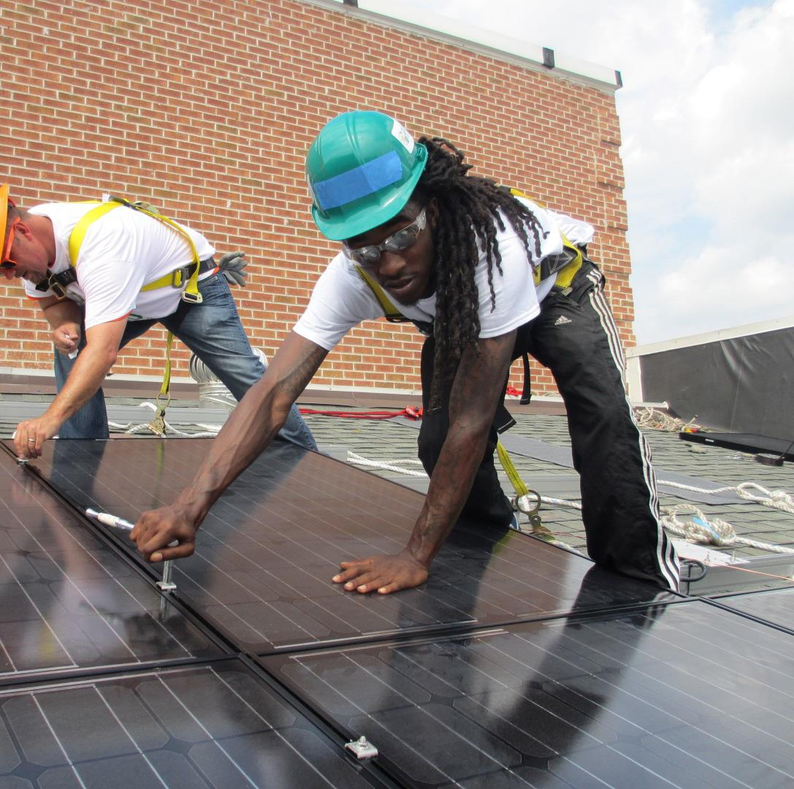

Participant Benefits
No upfront costs
Required savings for all participants
Comprehensive consumer protections
Comprehensive vendor requirements and management

Slide 8
Approved Vendors
Responsible for all aspects of solar installation for ILSFA projects
Ensure all program requirements are met, including:
  Community engagement in the development of ILSFA projects
  Minimum number of ILSFA project hours are performed by qualified job trainees
  Comprehensive consumer protections
  Project sites meet site suitability requirements
  System design and performance standards
  Quality assurance standards, including assessments via onsite and photo inspections

Slide 9
Grassroots Education Campaign Overview

Slide 10
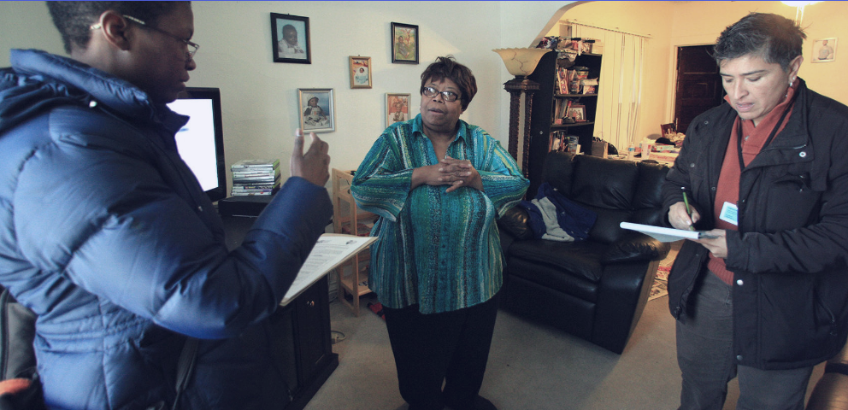
Grassroots Education Successes
Notes:
“Case study”

Slide 11
Grassroots Education Campaign Overview
Grassroots Education goal:
  Ensure the benefits of and opportunities provided by ILSFA reach low-income households and communities throughout Illinois
Campaigns will:
  Target geographies and households that are underserved
  Adapt messaging and methods to provide accessible information about the ILSFA program’s opportunities and points of entry
  Propose strategies and tactics with proven success

Slide 12
Environmental Justice Communities
Environmental justice (EJ) communities demonstrate a higher risk of exposure to pollution based on environmental and socioeconomic factors
2,422 of 9,683 census block groups in Illinois were designated EJs based on localized environmental and socioeconomic factors
Represents appx. 3.1 million people or 1.2 million households
Up to 60% of available grassroots education funding will be awarded to Grassroots Education proposals targeting EJ communities
Option for communities to pursue “self designation”

Slide 13
Environmental Justice Communities Map
Online tools have been developed to help you identify EJ communities across the state
EJ communities are located in approximately 25% of Illinois counties

Slide 14
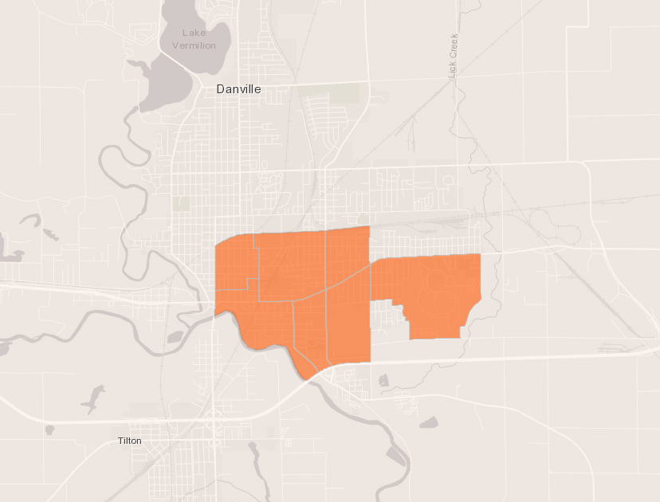
Danville Environmental Justice Communities

Slide 15
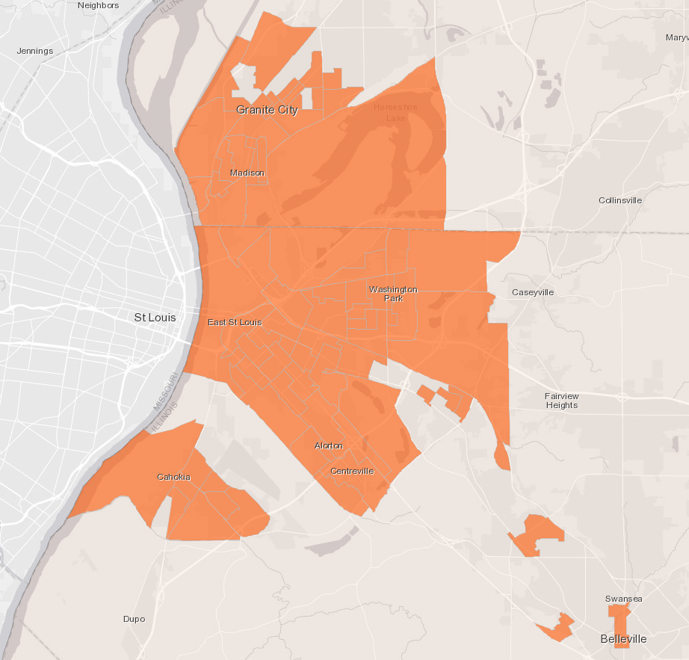
Metro East Environmental Justice Communities

Slide 16
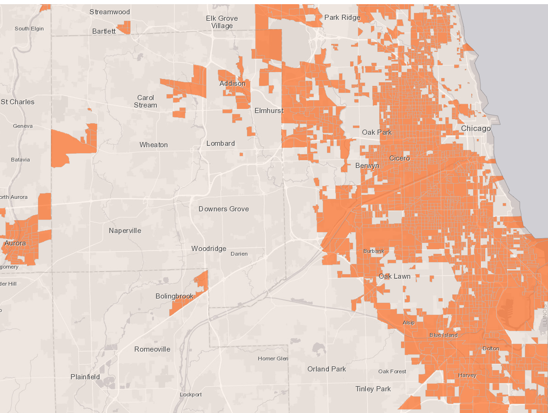
Chicago Metro Environmental Justice Communities

Slide 17
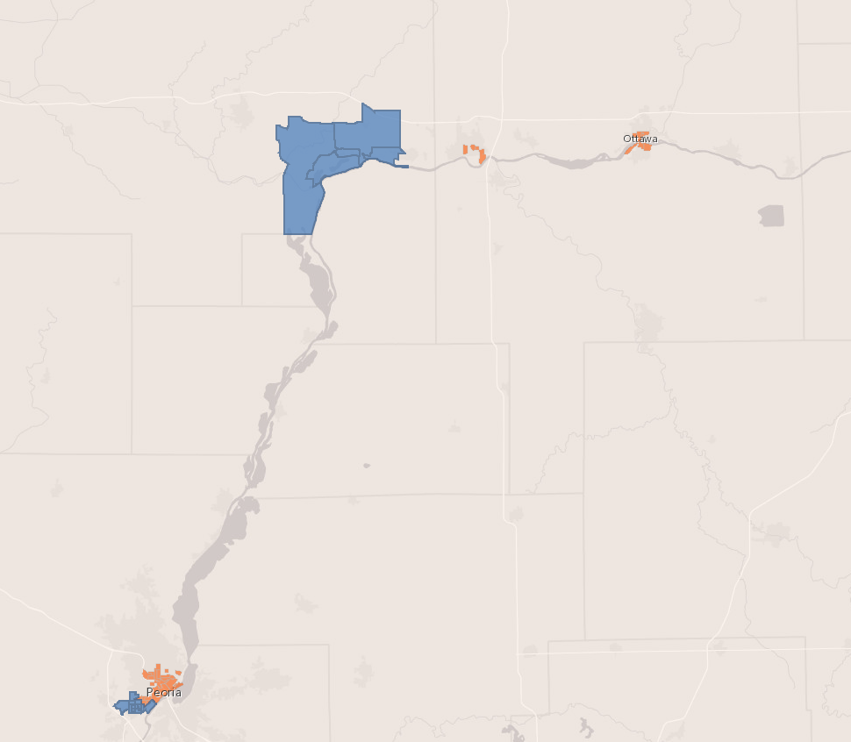
Environmental Justice Self Designation

Slide 18
Grassroots Education and Approved Vendors
Campaigns can:
  Directly and indirectly drive program participation
Campaigns cannot:
  Directly support particular Approved Vendors
In geographies without Approved Vendors, Grassroots Education campaigns may facilitate connections between communities and Approved Vendors
  Approved Vendors should be invited to participate in an equitable manner

Slide 19
Proposal Requirements

Slide 20
Grassroots Education Eligibility Requirements
Organizations must be registered non-profits (or partner with a fiscal sponsor)
Collaboration to leverage resources and strengths, in focus or geography, is encouraged
For groups that are not registered non-profits and require fiscal sponsorship, proposals should:
    Clearly specify roles and responsibilities
    Demonstrate an equitable approach toward decision making

Slide 21
Grassroots Education Eligibility Requirements
Organizations that have previously received grassroots education funds are encouraged to consider submitting proposals for collaborative campaigns with smaller groups (including those without 501(c)(3) status) who reflect their communities and groups prioritized in CEJA (e.g., returning citizens)

Slide 22
Award Information
  Up to 10-month contracts, expected to begin in August 2022
  Up to $100,000 for each selected organization
    Up to $500,000 may be allocated for Grassroots Education during this round
  Structured as “Time and Materials” contracts
  Budgets should be “fully loaded,” meaning they should include overhead in hourly rates
    Excel tables

Slide 23
Areas of Interest
Building awareness of and trust in solar energy and the ILSFA Program
Educating low-income households on opportunities to participate in ILSFA (e.g., the additional value of ILSFA vs. Illinois Shines/Adjustable Block Program for eligible participants)
Demonstrating how communities can access the benefits of solar such as economic development, job training and hiring, and reduced environmental impacts (campaigns focused on solar installations at single - family and small multi-family (2-4 apartments) are particularly encouraged)
Involving community members in stakeholder engagement processes that will help inform Illinois Solar for All approaches, policies, and processes in ways that benefit low-income and environmental justice communities

Slide 24
Campaign Focus
Campaigns that focus on helping single-family and small multi-family residence owners pursue distributed generation projects and that assist community residents in pursuing community solar are particularly desired

Slide 25
Request for Proposals (RFP) Evaluation Criteria
Final scope of work, campaign goals and metrics, and award amount corresponding to work to be provided will be negotiated during the selection process

Slide 26
Format and Required Information for RFP Submission
Respond to prompts and questions using a word or PDF document
Submit budget tables in Excel using provided templates
Submit necessary supporting documents
  IRS 501(c)(3) letter, if any
  Board list
  IL Secretary of State Certificate of Good Standing
  Most recent IRS Form 990, if any
  IL Standard Disclosure and Conflict of Interest form (if applying for >$50,000)
All information submitted electronically to grassroots@IllinoisSFA.com
Proposals are due by Wednesday, June 15, 2022 at 11:59 PM

Slide 27

Key Dates
May 6, 2022: Request for Proposals is available
May 16, 2022: First Q&A Webinar
May 24, 2022: Second Q&A Webinar
May 31, 2022: Questions on the RFP due to grassroots@illinoissfa.com
June 9, 2022: Q&A document posted to ILSFA’s website
June 15, 2022: Proposal submission deadline
August 2022: Selected grassroots education campaigns are announced
Late August 2022: Onboarding for selected organizations will begin

Slide 28

Questions?

Slide 29
Important Contacts
Laura Oakleaf,
Program Manager
Laura.Oakleaf@elevateenergy.org
(773) 906-5134
Elizabeth Corrado,
Grassroots Education
Elizabeth.Corrado@elevateenergy.org
(773) 321-2684
www.IllinoisSFA.com

